Slide 1
HTML 创建网页的结构
HTML
看到的网页
Notes:
Students are taking notes on this slide.

Slide 2
左右有什么不同？
Notes:
Have them turn and talk for a few mins, then bring the class together for a short discussion. Looking for things like, there are no tags in the rendered page, the font looks different, the indentation looks different… etc.

Slide 3
使用正确的语法创建一个开始和结束HTML标签。
Vocabulary: Guided Notes, HTML, tags, angle brackets, <p>
Notes:
Make sure to have a student read this aloud

Slide 4
Tag：标签
<p> 实务学堂 </p>
起始 Tag
结束 Tag
HTML 内容
Notes:
HTML is made up of tags. Students are taking notes on this slide.

Slide 5
这两个 tags 有什么不同?
<p> </p>
Notes:
opening tag/ closing tag

Slide 6
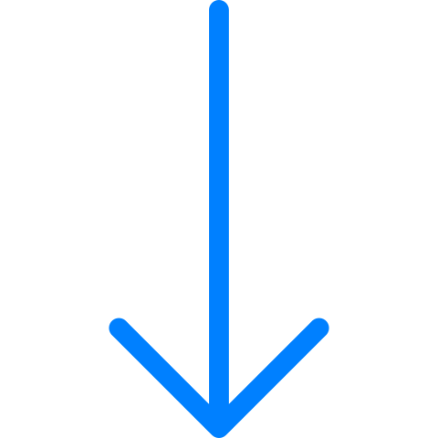
中间的文字是内容
<p> Hello </p>
Notes:
content

Slide 7
语法要正确
下面代码的错误是？
</p>hello!<p>

Slide 8
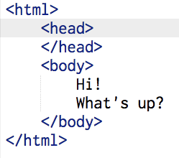
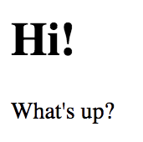
p：段落 h1：一级标题 em：强调 head：头 body：身体
<p>Hi!</p>, <body>What’s up?</body>
<h1>Hi!</h1>, <p>What’s up?</p>
<em>Hi!</em>, <text>What’s up?</text>
Notes:
Done in Google Classroom.

Slide 9
缩进，保持清晰
<html>
<body>
<p>content</p>
</body>
</html>
Notes:
Students will learn more about writing clean code later in this unit. Add some questions for students. Where is the paragraph tag? Where is the closing html tag? Ask students if they can see which elements are inside the others i.e. the p is inside the body and the html.

Slide 10
找错误
<html>
<body>
<h1>Hello
<p>well hello there!</h1></p>
</body>
</html>
Notes:
On this slide and the next plan to click into the slides and make changes as students tell you what to change so that they can see the correct answer.wer.

Slide 11
找错误
<html><body><h1>Hello</h1></html>
<p>There is more!</p>
</body>
Notes:
Do a turn and talk first, then call on students. Click into the slideshow and fix the code so students can see the correct answer.
Guide students in understanding that without proper indenting it’s more difficult to find problems.

Slide 12
作业
修改你的网站，包括下面的效果
用上这些Tags: <p>, <strong>, <em>, <marquee>, <mark>, <sub>, <sup> <h1>, <h2>, <h3>
给一些文字加“下划线”
用上这些Tags：<code>, <small>, <del>, <q>

Slide 13
创建具有属性attributes的HTML元素，添加链接
Vocabulary: attributes, href, anchor tag <a>

Slide 14
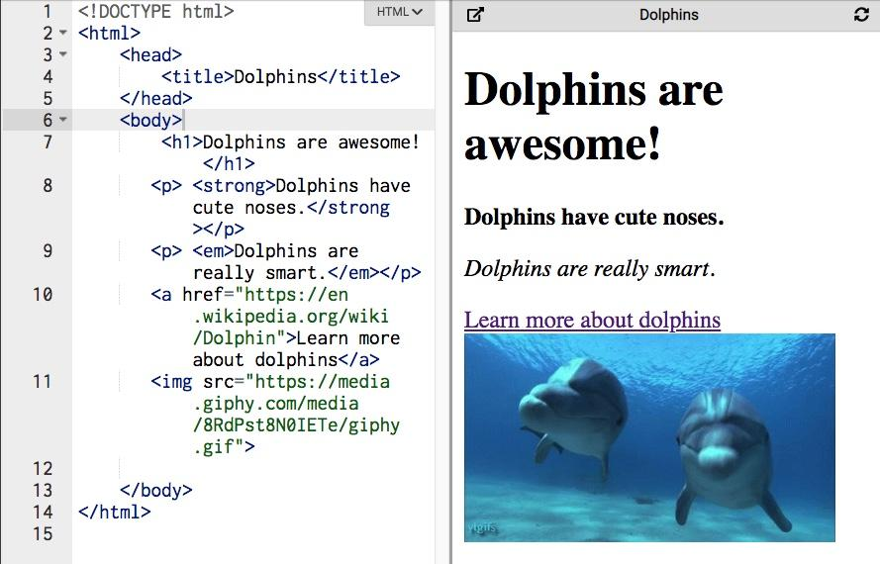
超链接
Notes:
Expected answers for question 1:
Heading, paragraph, bold, italics and an IMAGE and LINKS!! (Make sure students say there is an image!)

Slide 15
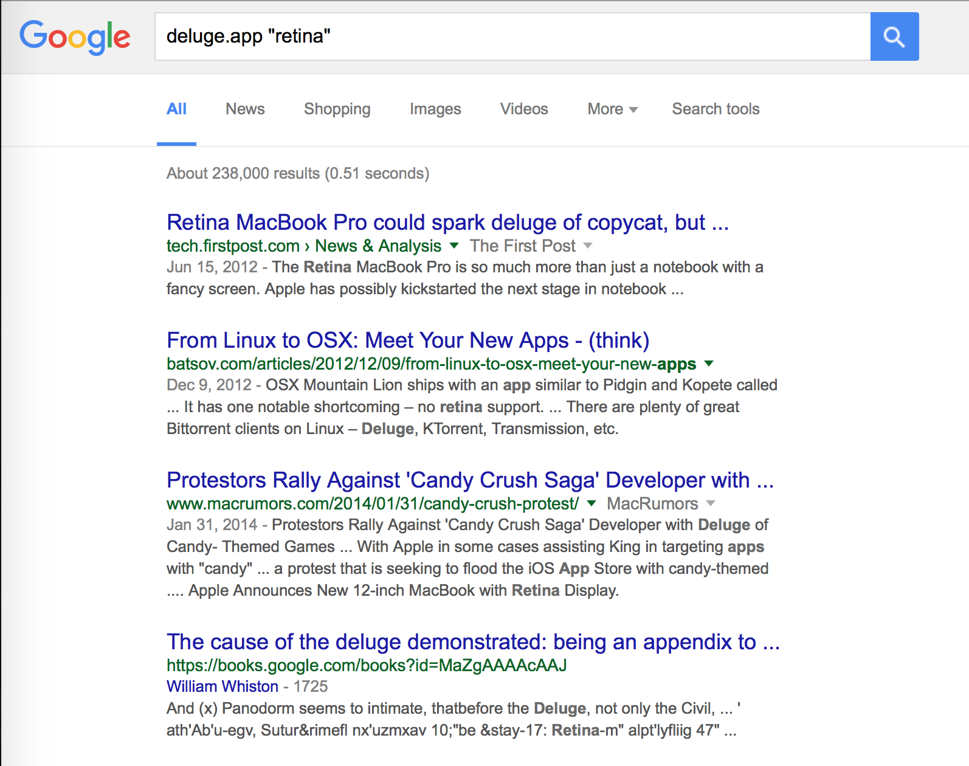
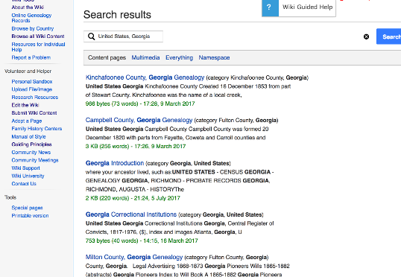
超链接的显示有什么特点？
Notes:
Prompt students to talk about colors. Are links ever underlined? Do links often have different text styles? (3 mins)

Slide 16
HTML Attributes 属性
属性提供有关元素的其他信息
属性始终包含在开始标记中
所有HTML元素都可以具有属性
属性通常以名称/值对的形式出现，例如：name =“ value”
Notes:
Attributes help add specificity to tags! So in this case, we are adding a hyperlink reference to tell the anchor tag where to go.

Slide 17
href Attribute
Anchor （锚点）tags 有 href 属性
这告诉浏览器链接在互联网上的位置。
<a href ="https://CodeNation.org/"> Code Nation </a>
结束标签
属性值
用户会看到的文本，而且可以点击
Notes:
** note for students why you don’t need to close the href in the closing tag. (</a href>)
Ask students what the attribute name and value are here.

Slide 18
href Attribute
可以将href属性想像成信封上的“收件人：”。该属性的值像地址一样说明了去向。
<a href="https://CodeNation.org/">Code Nation</a>
href =
"https://CodeNation.org/"
To:
123 Main Street, Apt 2A
New York, NY
Notes:
Because anchor <a> is the tag and “href” is just an attribute, the closing tag only has </a> -- no need to close the href because it is not a tag

Slide 19
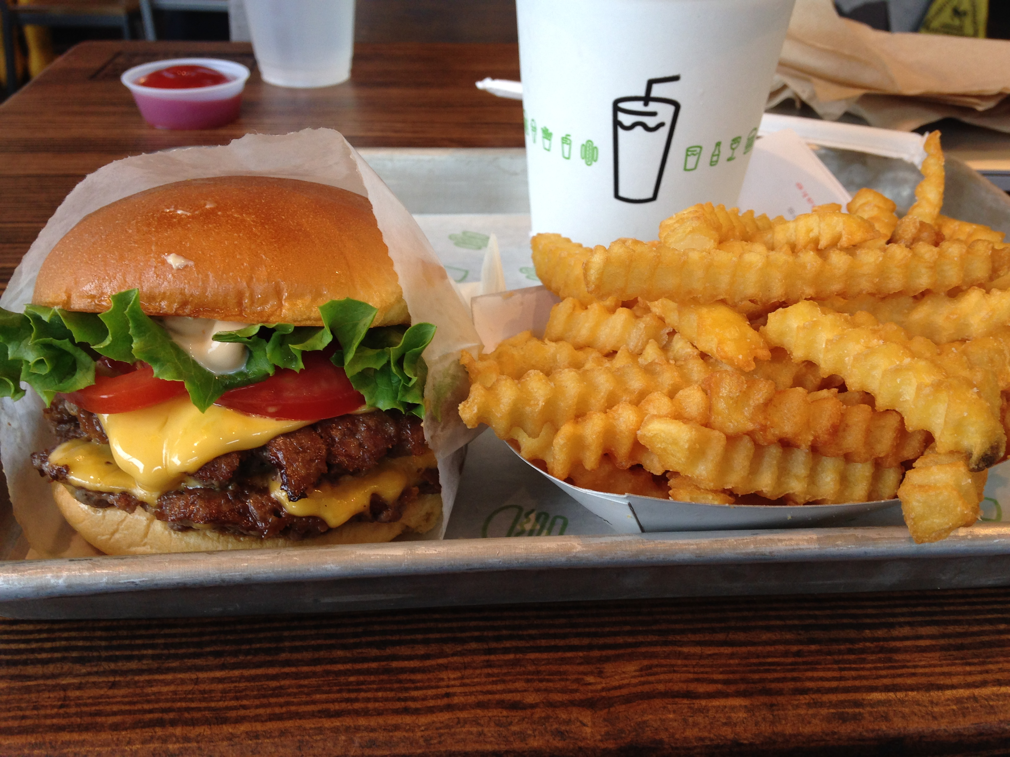
用户将在网页上看到什么文字？ （通常为蓝色） 用户单击蓝色文本时会去哪里？
<a href="https://www.shakeshack.com">Shake Shack</a>
Notes:
If you're in the Bay Area change this slide to in n out :) (1 min). Take student responses, make sure they are able to answer these questions correctly.

Slide 20
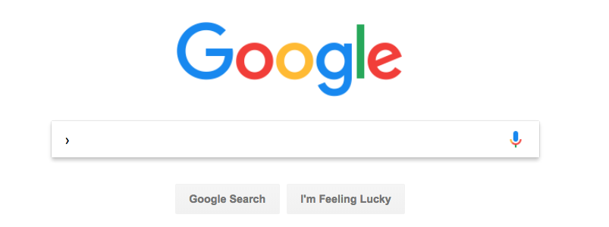
哪个代码创建到 https://www.google.com/的链接？ 当用户点击“ Google it！”字样时，会去哪里？
<a href="https://www.google.com"></a>Google It!
<a href="https://www.google.com">Google it!</a>
<a="https://www.google.com">Google it!</a>

Slide 21
创建具有属性的HTML元素，将图像添加到其页面
Vocabulary: src attribute, image tag, self-closing tag

Slide 22
源属性
Image（图像） 标签有一个源属性(src)告诉浏览器，图像在互联网上的位置。
<img src=“https://dogs.com/image.jpg”>
图像在互联网上的位置
源
Notes:
Make the connection between the attribute they learned about in the previous lesson. Reinforce that attributes give tags special qualities. Src tells the computer where to get something.

Slide 23
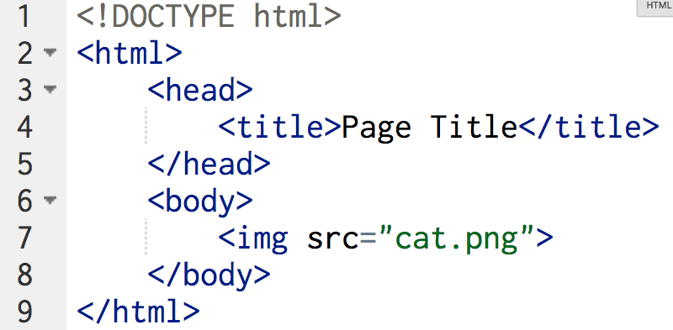
哪里是图像源属性？
Notes:
Make the connection between the attribute they learned about in the previous lesson. There's an attribute name an equal symbol and quotation marks
Reinforce that attributes give tags special qualities. Src tells the computer where to get something.

Slide 24
比较不同
<a href="https://google.com">Go to Google</a>
<img src="https://i.ytimg.com/hqdefault.jpg">
Notes:
(1 min)
Self-closing tag

Slide 25
图像标签
<img src="https://i.ytimg.com/hqdefault.jpg">
使用src属性
标签是自动闭合的。这意味着它不需要结束标签！
<img>没有内容。图像本身就是内容。
Notes:
What's the difference between a self closing tag and a traditional tag?

Slide 26
调试和发现代码中的错误
Vocabulary: debug, reference table
Notes:
Reinforce that we will have an objective and vocabulary for every lesson. Prompt students to study the vocabulary terms between classes.

Slide 27
保持代码整洁，更易于阅读，更容易发现错误或错别字。
记得：
- 按Enter或回车键，以开始新的代码行
按Tab键，缩进
编写干净的代码
调试的第一步是预防。确保您正在编写干净的代码以防止错误。
<html>
<body>
<p>content</p>
</body>
</html>

Slide 28
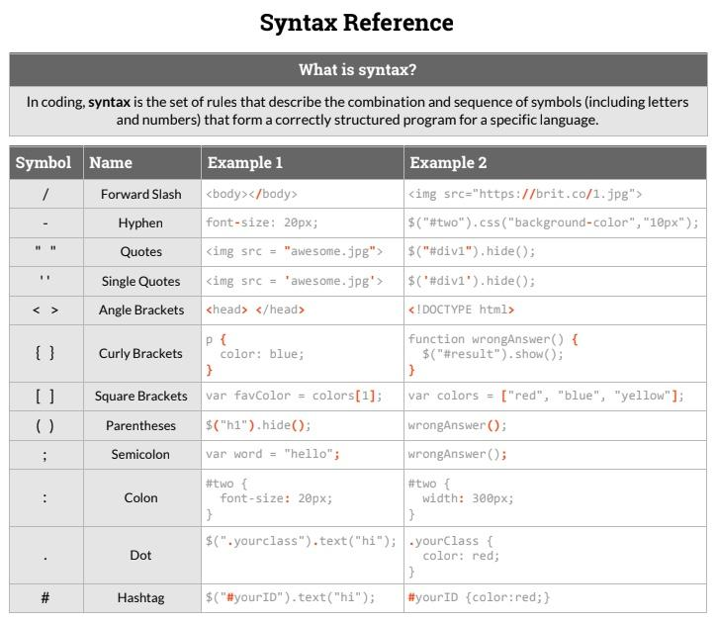
参考表
编码人员一直在查询信息并寻求帮助！
Code Nation制作了易于使用的参考表，因此您可以在项目或独立练习期间，快速找到问题的答案
Notes:
Teacher Notes:
What other classes do you use reference tables in?
How often do you use them?
How does Code Nation's reference table differ from others?

Slide 29
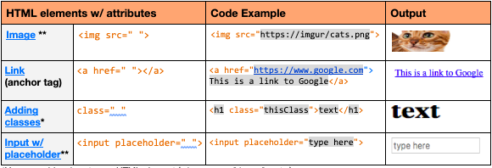
使用参考表
参考表可以帮助您：
遇到错误时，找到正确的语法
找到正确的代码编写方式
学习正确的语法
在本单元中，您将使用参考表的HTML部分。
概念名字
输出
语法
例
Notes:
The reference table should be set in a topic at the top of the Classwork tab in Google Classroom.

Slide 30
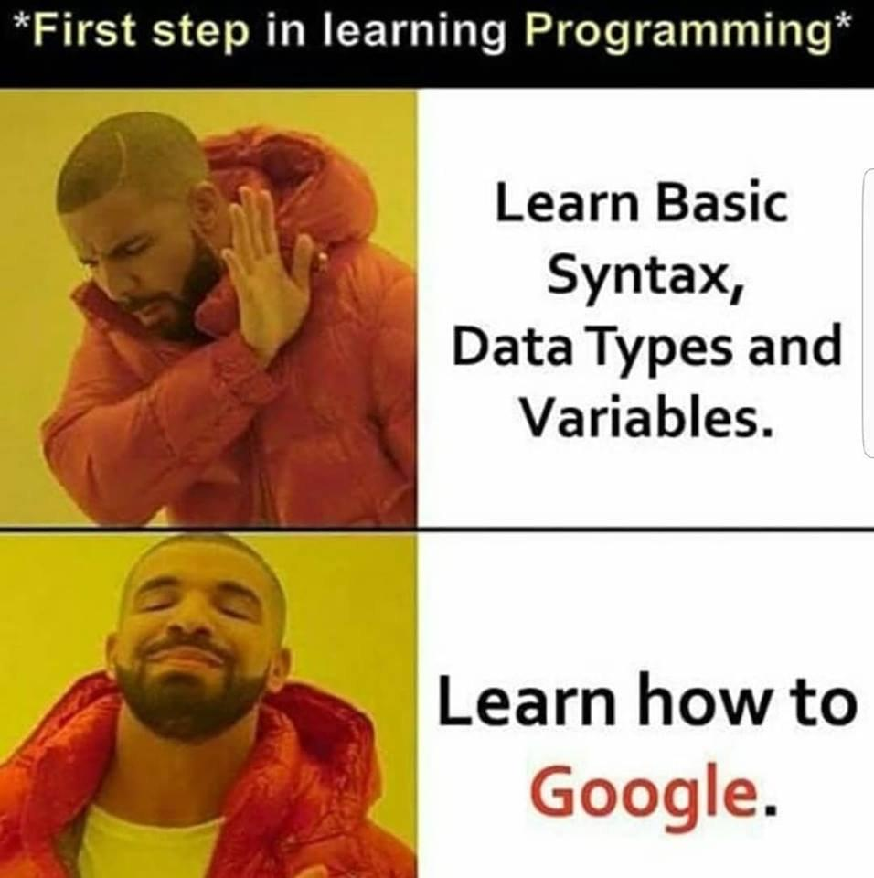
在网络上寻找答案
每个开发人员和大多数专业人士都会告诉您，他们每天多次使用Google。没有人记得编写每种类型代码的确切方法，并且Google有很多资源可以提供帮助！

Slide 31
选择哪行代码可以产生下面的效果
<p>I love HTML!</p>
I love HTML!
<p>I love HTML!<p>
I love HTML!
Notes:
All exit tickets will be multiple choice questions. They will be automatically graded in Google.

